Slide 1

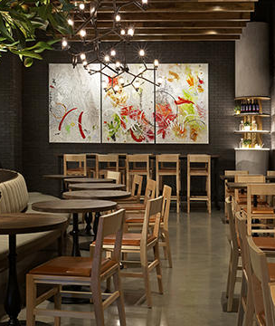
BUSINESS ANALYSIS ON LEVELS PUB

Slide 2
ABOUT
Levels is a Laid-back, 2-story pub drawing a festive crowd for live bands, beer, cocktails & casual global eats. One of the coolest addresses in South Asia, is an atmospheric cafe bar, which serves great drinks and great music. The Cafe Bar has two floors. The ground is set up as a restaurant serving food while the first floor is reserved for live bands’ performances every night.
It has been collecting data about the customers and what they have been purchasing. Also, they membership for customers, many who have subscribed to their newsletters

Slide 3
Understanding the Business
Lot of customer transaction data is being accumulated but not tapped. Levels management needs to understand and deep dive into customers journey, and gradually take certain actionable decisions. The senior management and marketing teams need to understand and analyze the data, to drive more campaign, understand where things are not as expected, need investment for better customer experience.

Slide 4


DESIGN APPROACH
CUSTOMER ANALYSIS
ORDER ANALYSIS
BUYING PREFERENCE

Slide 5


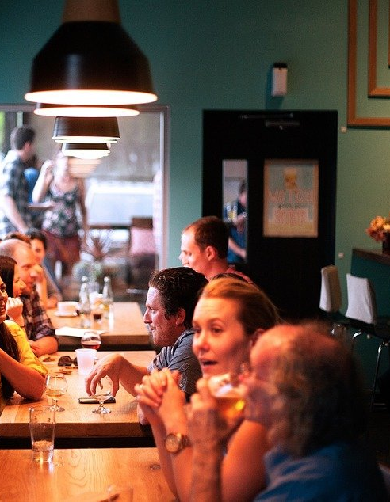
CUSTOMER ANALYSIS

Slide 6
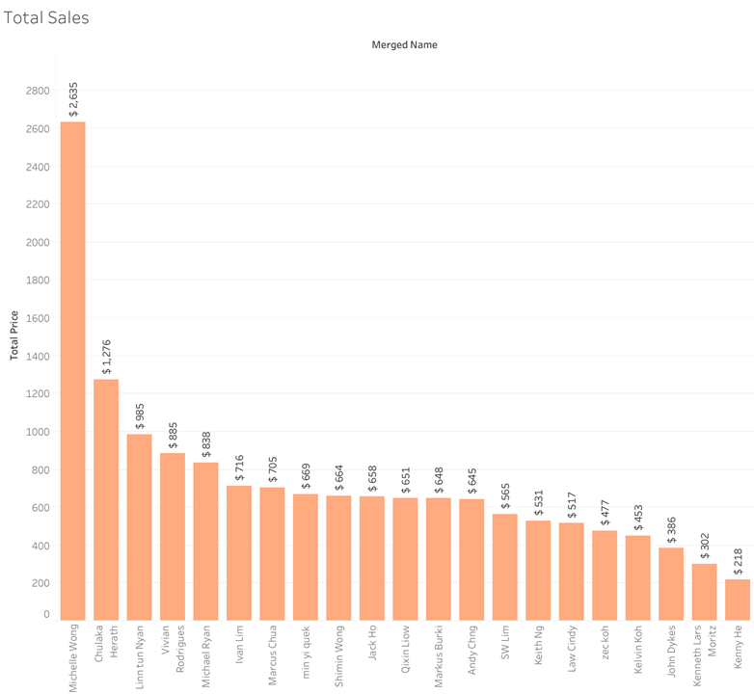
TOTAL SALES

Slide 7
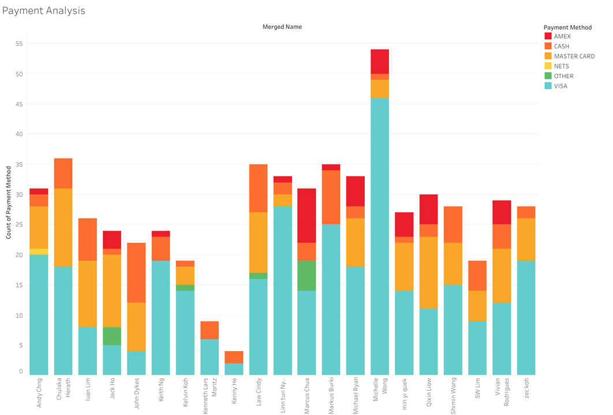
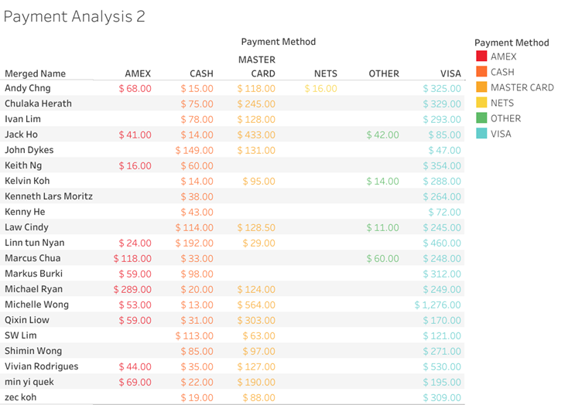
PAYMENT METHOD ANALYSIS

Slide 8
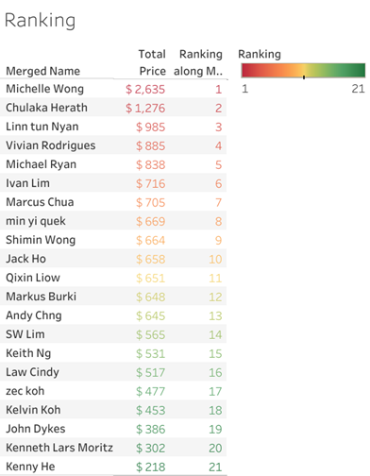
CUSTOMER RANKING

Slide 9
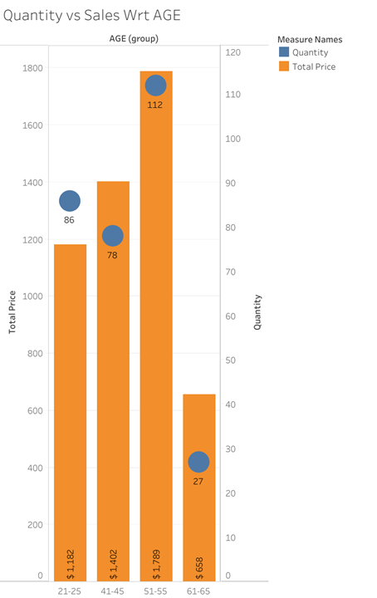
QUANTITY BOUGHT AND SALES ANALYSIS BY AGE SEGMENT

Slide 10
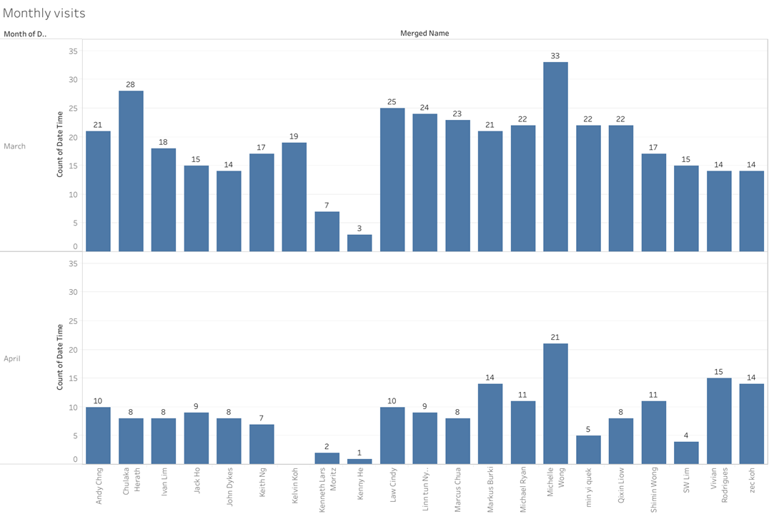
MONTHLY VISIT ANALYSIS

Slide 11
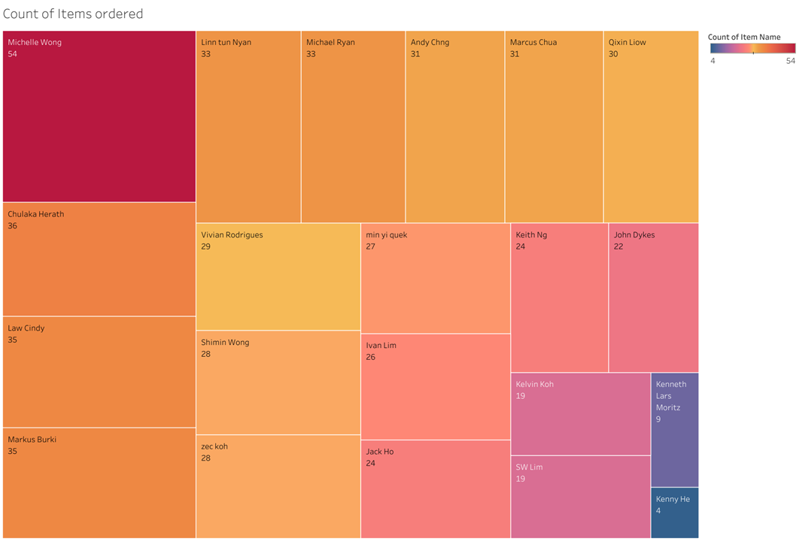
COUNT OF ITEMS ORDERED

Slide 12
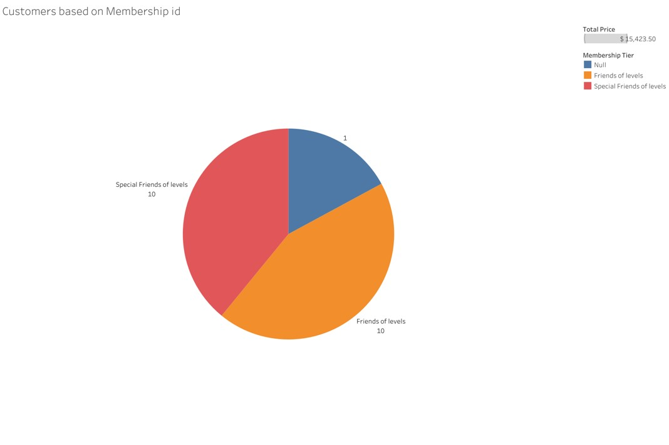
TREND OF SALES BASED ON JOINING MEMBERSHIP

Slide 13
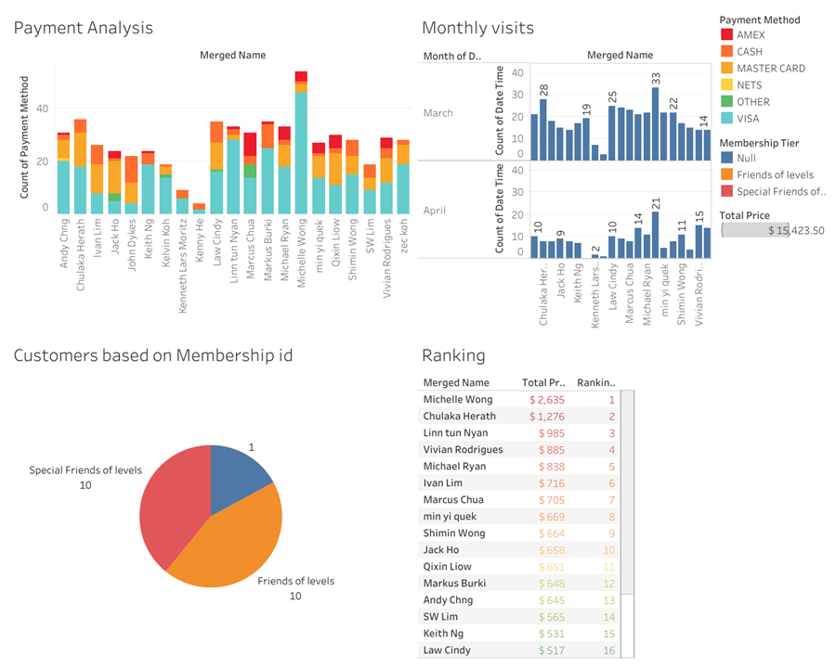
DASHBOARD 1

Slide 14
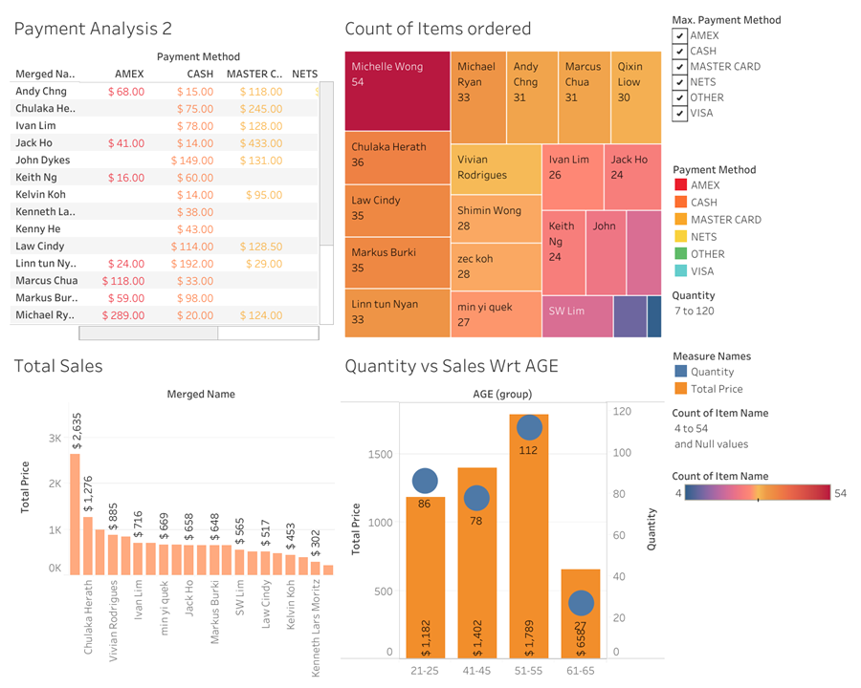
DASHBOARD 2

Slide 15
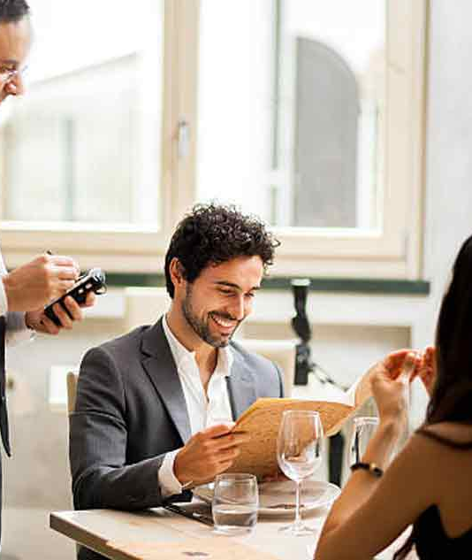
ORDER ANALYSIS

Slide 16
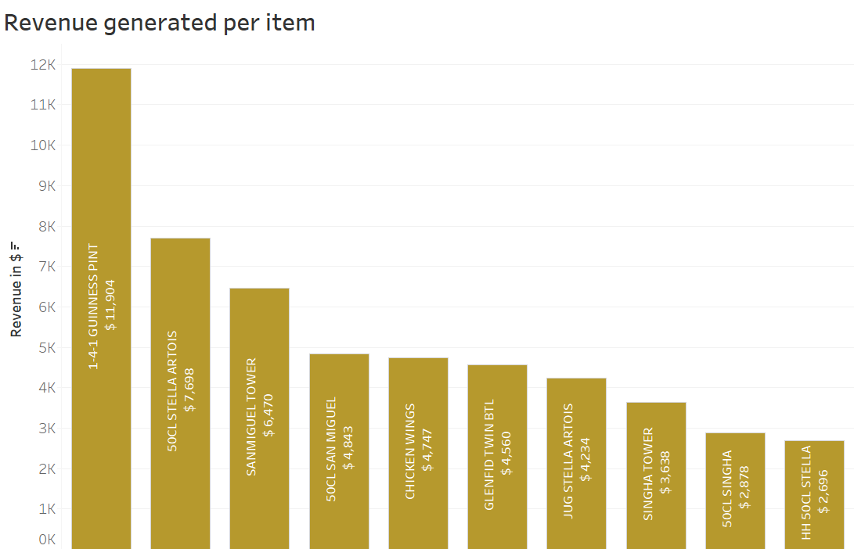
ITEM ORDERED ANALYSIS

Slide 17
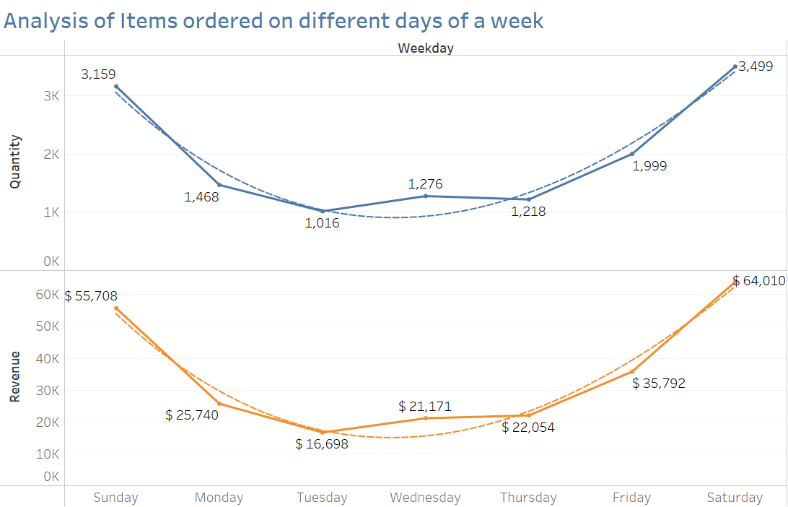
WEEKDAY TREND ANALYSIS

Slide 18
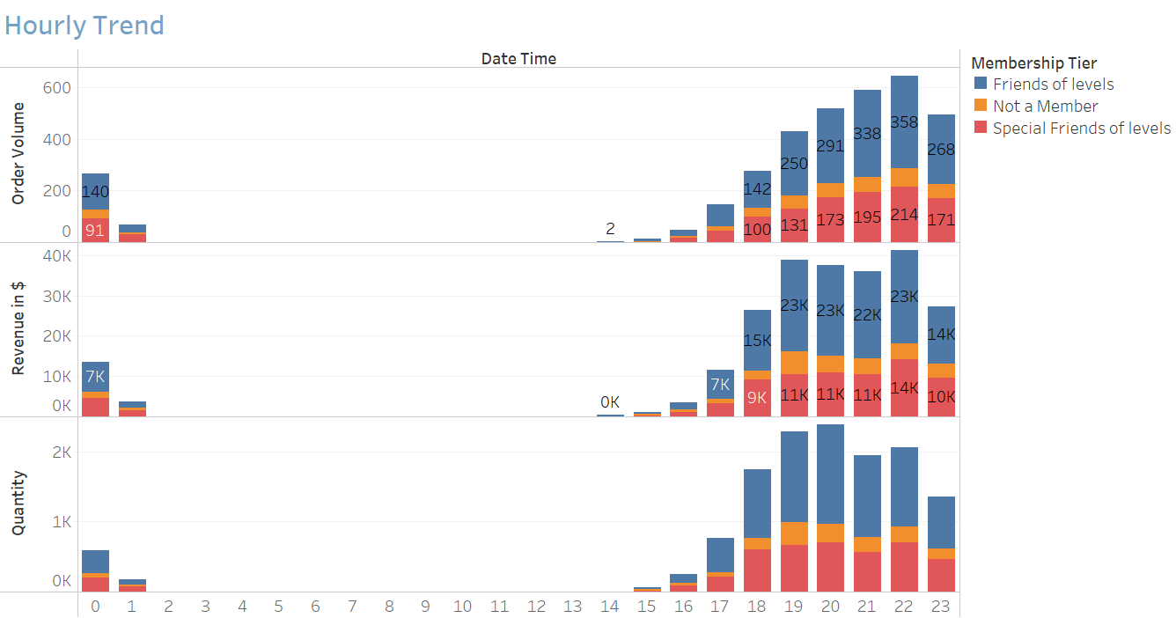
HOURLY TREND ANALYSIS

Slide 19
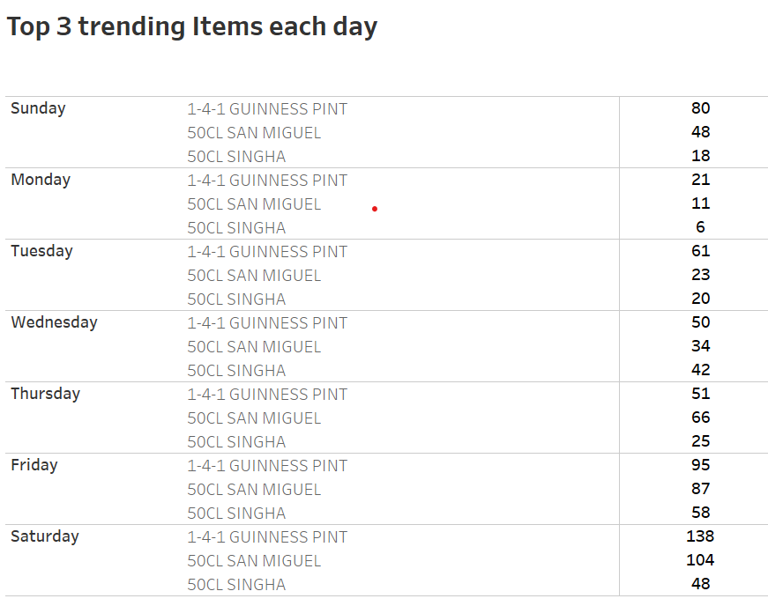
MOST TRENDING CUSINES
Weekday Item Name Quantity

Slide 20
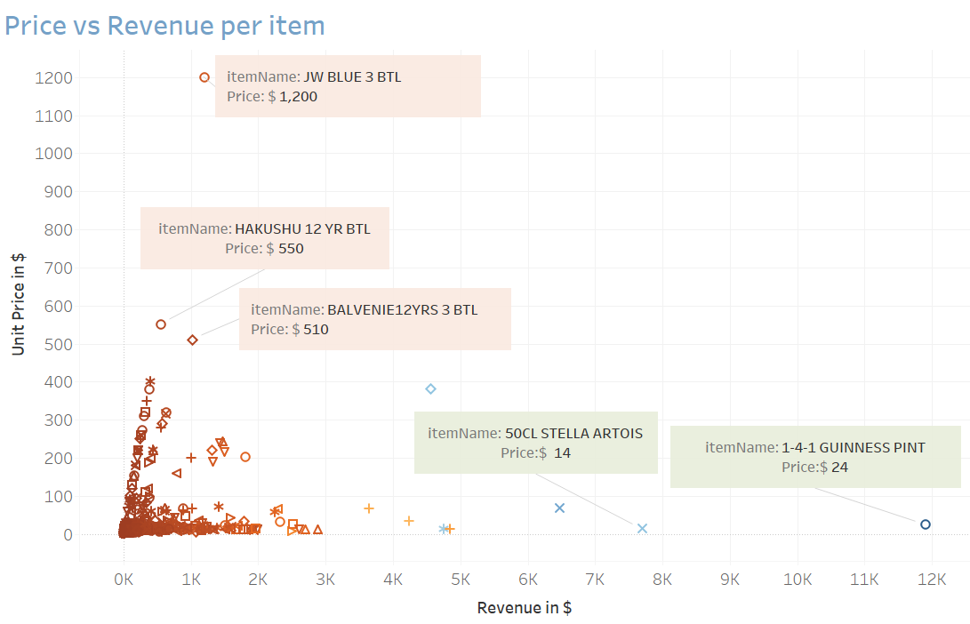
PRICE OF ITEM AND REVENUE GENERATED ANALYSIS

Slide 21
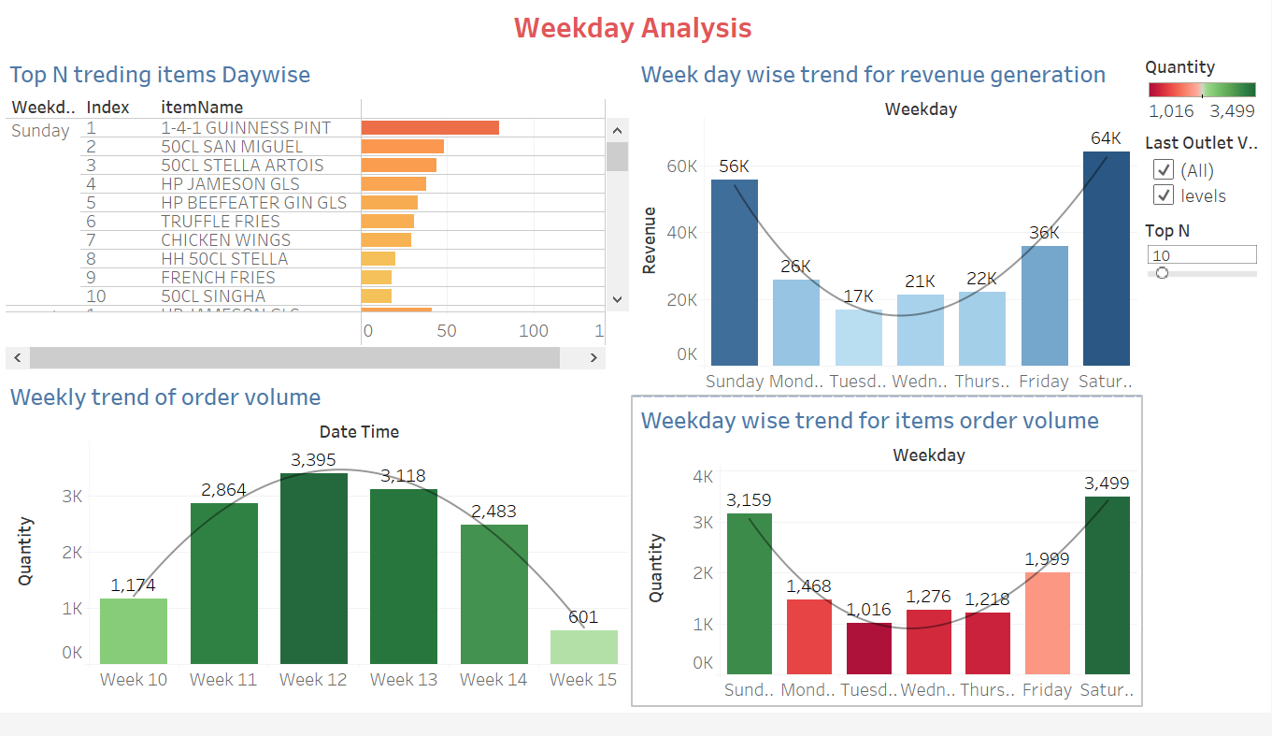

Slide 22
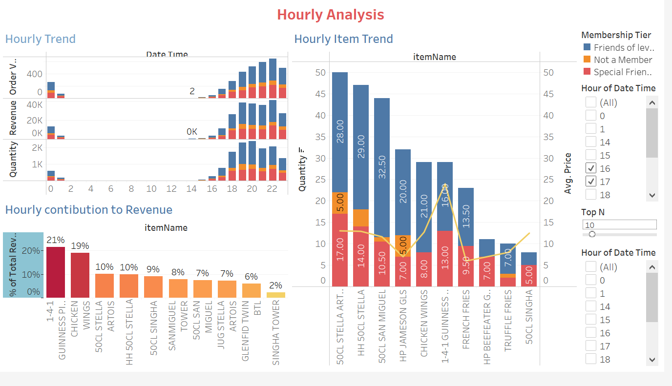

Slide 23
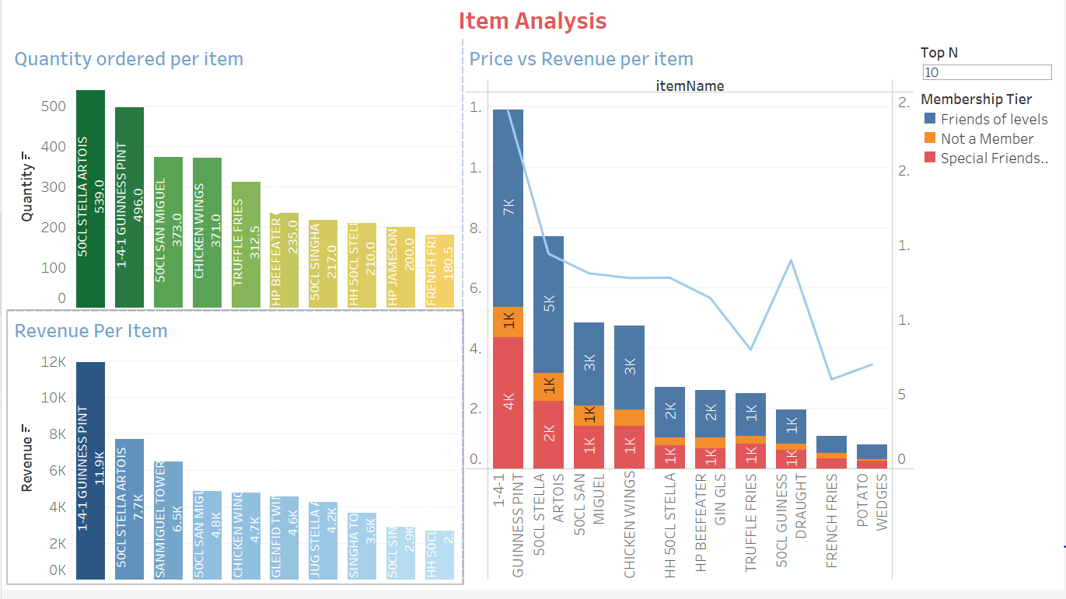

Slide 24

BUYING PREFERENCES

Slide 25
BUYING PREFERENCE
Special Items
JUG San Miguel
Chivas 18yrs GLS
HP Beefeater Gin GLS
Jager mister GLS
French Fries
50CL Singha
Discount Items
Guiness 50 CL
Jug Stella Artois
Gran Merlot BTL
Chicken Wings
HP Jameson GLS
Hot tea
Here ,the buying preference is entirely based on the Customers liking and their choice of preference.
Based on the analysis we have listed out the special items as well as items with discount.

Slide 26
STORY NARRATION

Slide 27
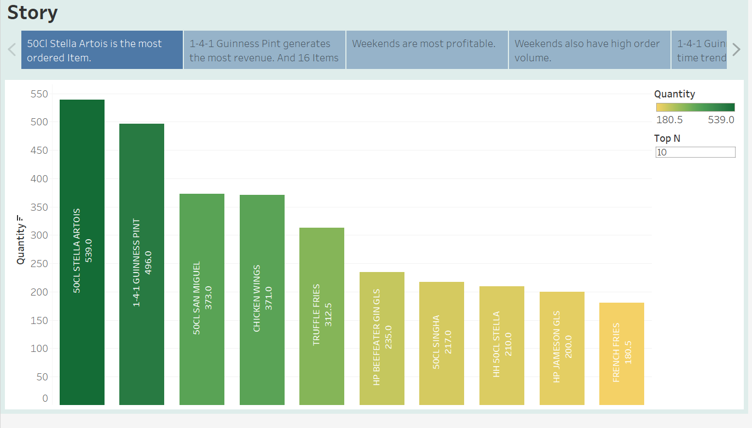
ORDER ANALYSIS

Slide 28

ACTIONABLE STRATEGIES

Slide 29
STRATEGIES
Items which are priced cheaper are generating much more revenue than item which are costly. For example GUINNESS PINT is priced at $24 and is generating a revenue of $11904, while JW blue which costs $1200 dollars but is generating a revenue of only $1200 in one month. So levels can add more items similar to GUINNESS PINT on the menu, which will boost the revenue generated.
Specifically target customers from membership tier and give offers according to the tier.
There is high number( 179)of items which are generating less than 100$ of revenue. So they need to enhance the quality of those items and remove few items if required.
Free home delivery and special offers on weekdays.
Refer your friends and get a free lunch.
From the data we have analyzed , we have listed out the Special Items which was being ordered the most.
In order to increase the revenue on least ordered items, we have decided to keep discounts for those items during the weekdays in future.

Slide 30

THANK YOU

